Slide 1
Final Project Report: World Cities
Sajid Hossam • 29.04.2025

Slide 2
Overview
About
Analyzing World Cities Data and get insights that help business owners or the government.
Steps
Data Collection
Data Cleaning
Data Analysis
Data Interpretation
Data Visualization
Decision Making
Question
How can we use this data?

Slide 3
Progress - Data Loading & Initial Exploration
Accomplishment 1
We've taken an initial look at our global cities data. We've noted some gaps in information for things like country codes and population figures for certain cities, which we'll need to address. The good news is that we don't have any repeated entries in our data.
Accomplishment 2
We also got a general sense of the numbers involved, like the range of city populations and their locations on the globe. We double-checked that all our location data (latitude and longitude) makes sense and falls within the correct global boundaries.
Finally, we looked at how cities are marked as capitals in our data, and we've seen that this information is also missing for some entries.

Slide 4
Progress - Data Cleaning
Accomplishment 1
We then cleaned up city and region names and removed any exact duplicates. We also removed some unnecessary columns. For missing information, we filled in the population for one city, marked unknown capitals, and estimated missing populations based on the country's average. Finally, we ensured population numbers were correct and removed any entries with zero population.

Slide 5
Progress - Data Cleaning
Accomplishment 2
Next, we created population size categories (Small, Medium, Large, Mega) to help with our analysis. For missing region names, we used location data (latitude and longitude) to try and automatically fill them in using an online service. As a backup, if we couldn't find a region name, we used the country name instead. Finally, we double-checked our location data to ensure everything was within the correct global boundaries.

Slide 6
Progress - Data Validation, View, Export
Accomplishment
Moving on, our final steps involved ensuring the cleaned data was ready for use. We made a safe copy of our work and double-checked that we had successfully filled in all the missing information. To make it easy to review, we created a simple, interactive view of the cleaned data. And lastly, we saved this finalized and clean dataset into a new file, ready for the next stage of our analysis.

Slide 7
Progress - EDA
Accomplishment
Now that we have our clean dataset, we started exploring it to understand the information better. We took a peek at the first few entries and looked at the basic statistics for our numerical data, like population and location. We also confirmed that our cleaning process was successful and that we no longer have any missing information or duplicate entries. Finally, we counted how many cities we have in our data for each country to get a sense of the distribution.

Slide 8
Progress - Visualization
Accomplishment
To better understand the data, we created visuals. We charted the countries with the most cities and the top populated cities. An interactive map lets you explore all cities. We highlighted the largest and smallest cities on a map. We also analyzed city sizes in the Northern and Southern Hemispheres using different types of charts and maps to show the distribution.

Slide 9
Insights

Slide 10
🌟 City with Largest Population:
city Tokyo
country Japan
admin_name Tōkyō
population 37732000
lat 35.6897
lng 139.6922
🏡 City with Smallest Population (>0):
city Sabhā
country Libya
admin_name Sabhā
population 2
lat 27.0389
lng 14.4264
🏙️ Country with the Most Cities:
country
India 6824
🌏 Country with Highest Total City Population:
China: 1,403,084,181
📊 Country with Highest Average City Population:
Singapore: 5,983,000
🏆 Countries with Average City Population > 1 Million:
country
Singapore 5,983,000

Slide 11
Top 10 Most Populous Cities and their Percentage of Total Dataset Population:
city country population pop_percentage
0 Tokyo Japan 37,732,000 0.72%
1 Jakarta Indonesia 33,756,000 0.65%
2 Delhi India 32,226,000 0.62%
3 Guangzhou China 26,940,000 0.52%
4 Mumbai India 24,973,000 0.48%
5 Manila Philippines 24,922,000 0.48%
6 Shanghai China 24,073,000 0.46%
7 São Paulo Brazil 23,086,000 0.44%
8 Seoul Korea, South 23,016,000 0.44%
9 Mexico City Mexico 21,804,000 0.42%

Slide 12
city Counts by Hemisphere and Population Category:
population_category Large Medium Mega Small
hemisphere
Northern 657 4610 37 35517
Southern 71 817 6 5831
Percentage Distribution within each Hemisphere:
population_category Large Medium Mega Small
hemisphere
Northern 1.61 11.29 0.09 87.01
Southern 1.06 12.15 0.09 86.71

Slide 13
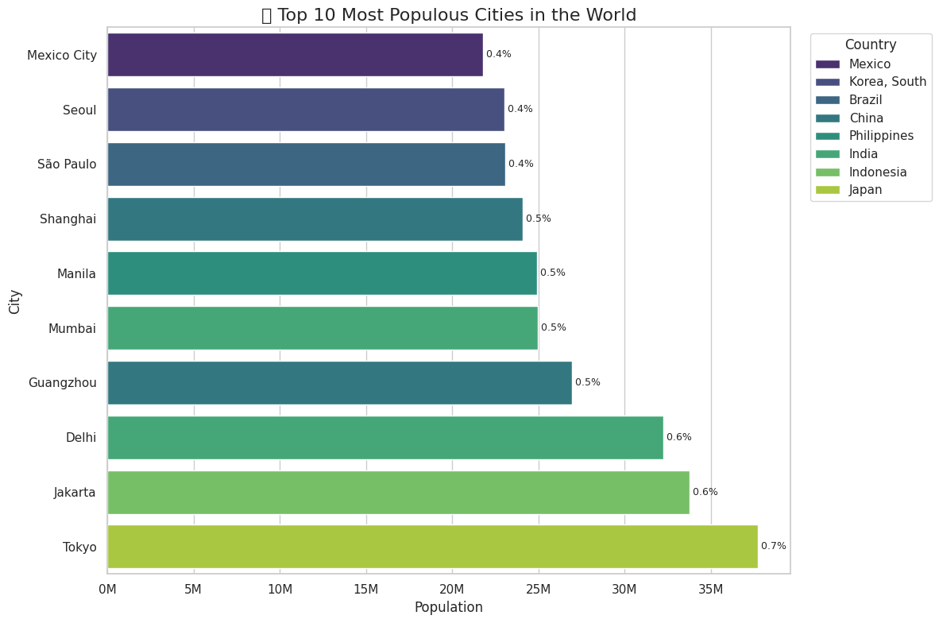

Slide 14
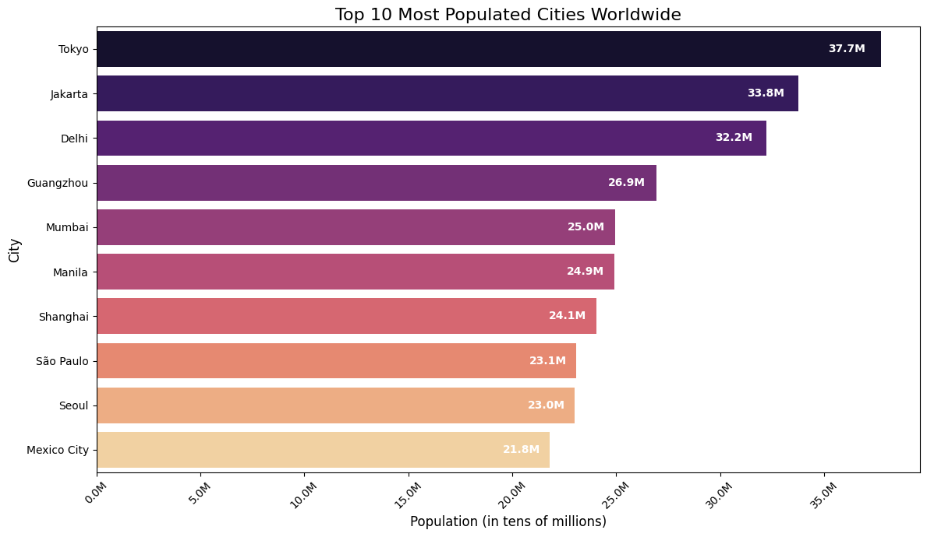

Slide 15
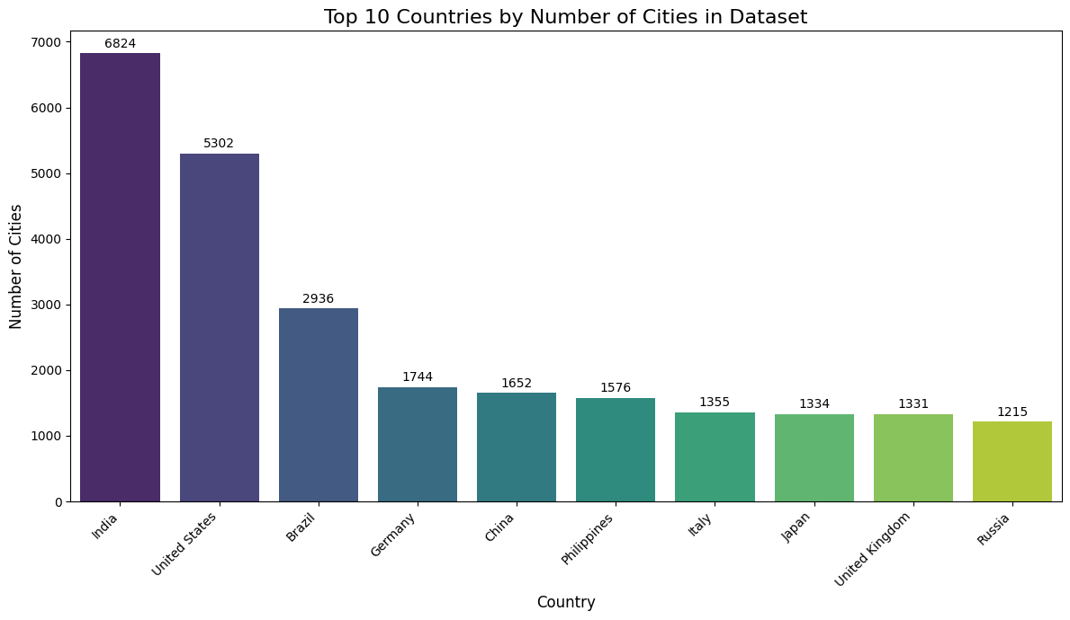

Slide 16
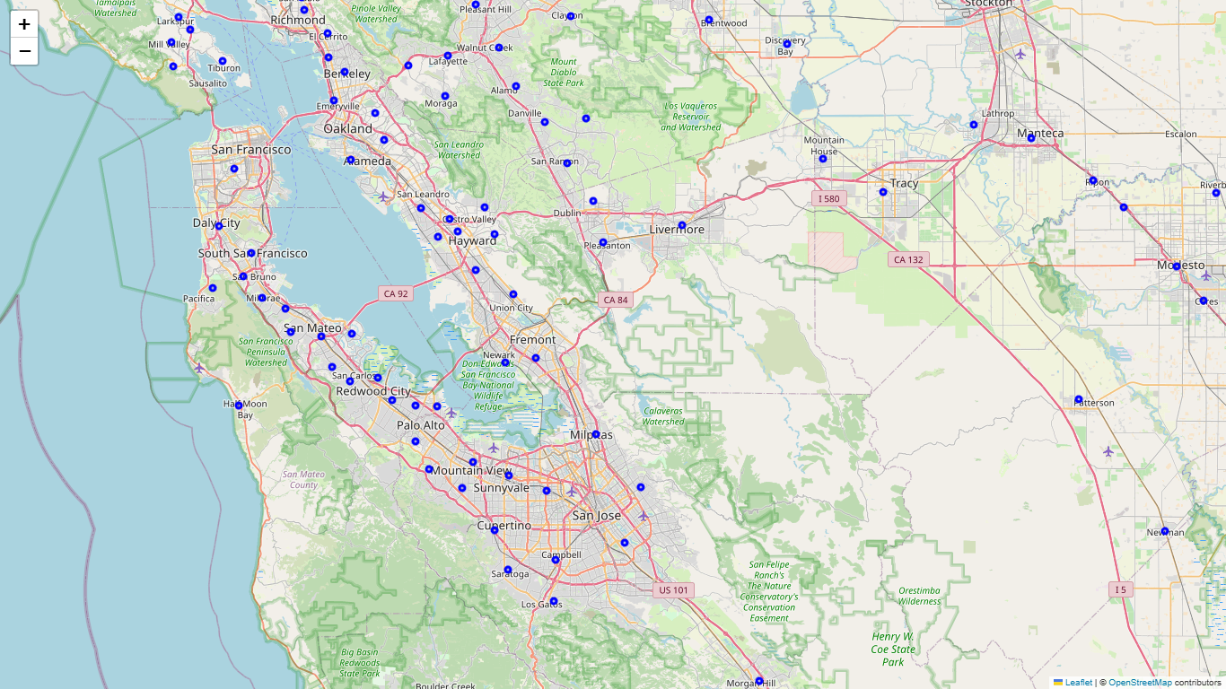

Slide 17
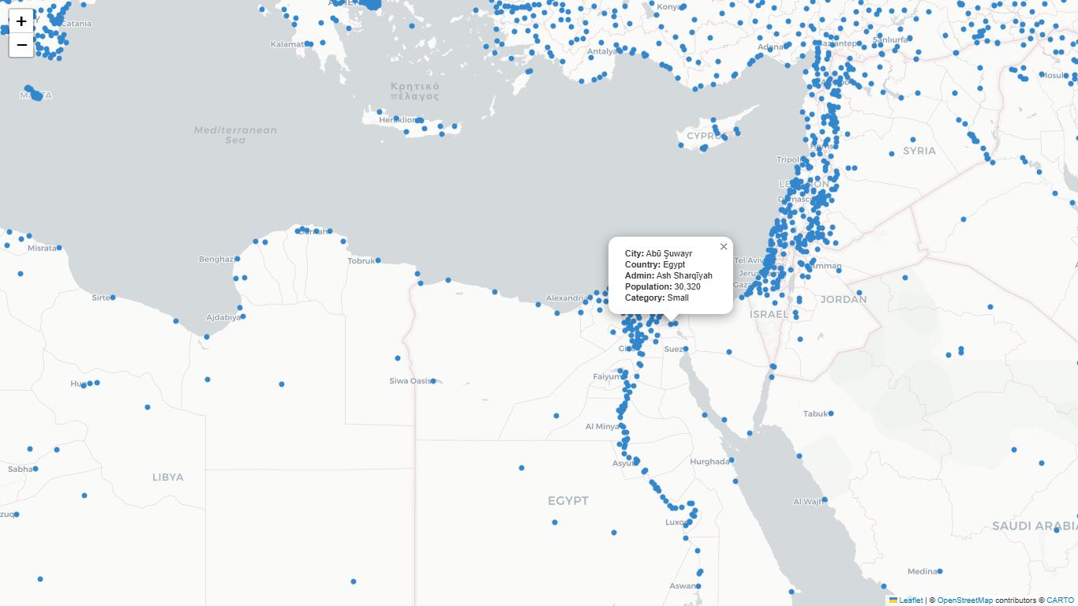

Slide 18
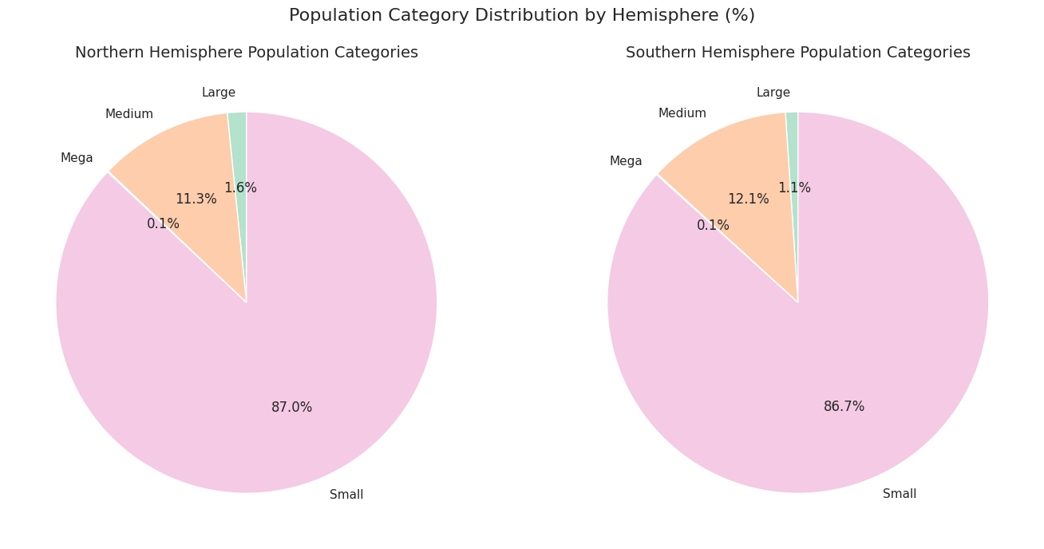

Slide 19
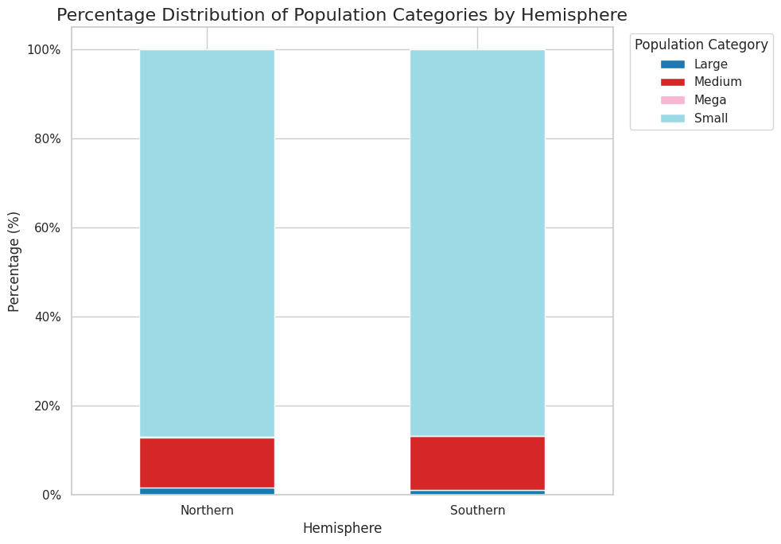

Slide 20
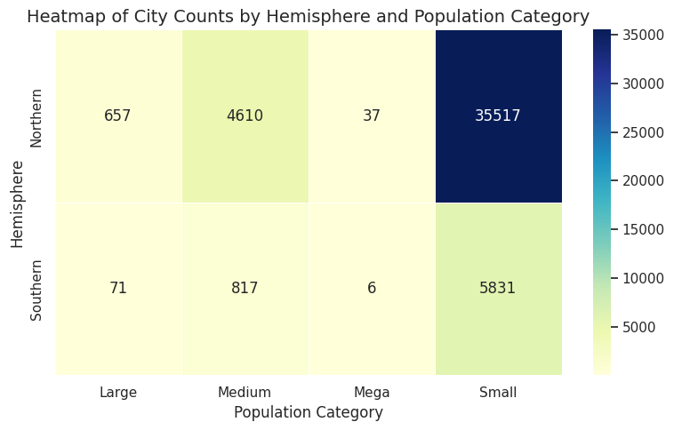

Slide 21
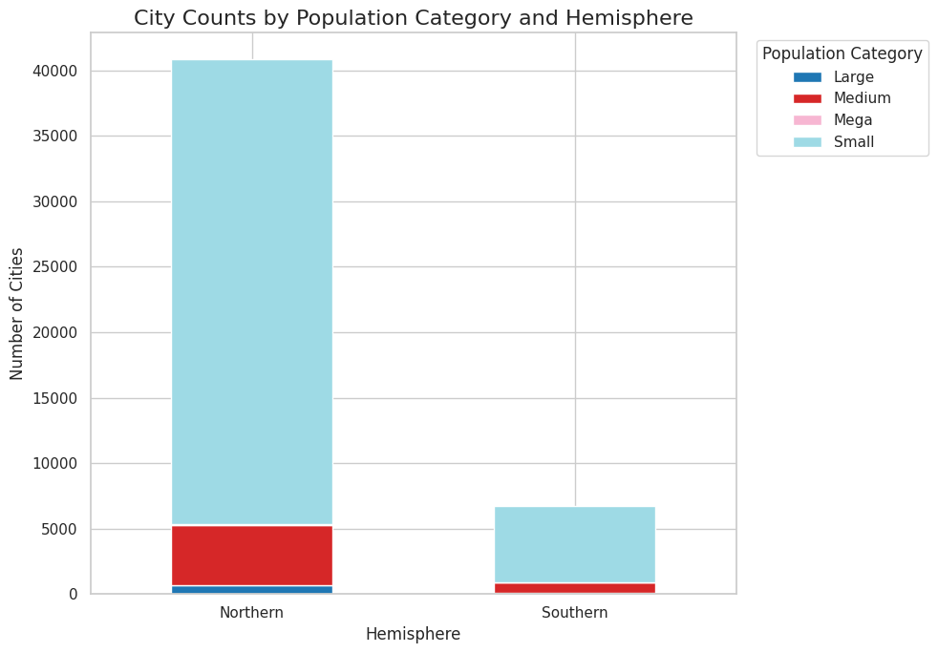

Slide 22
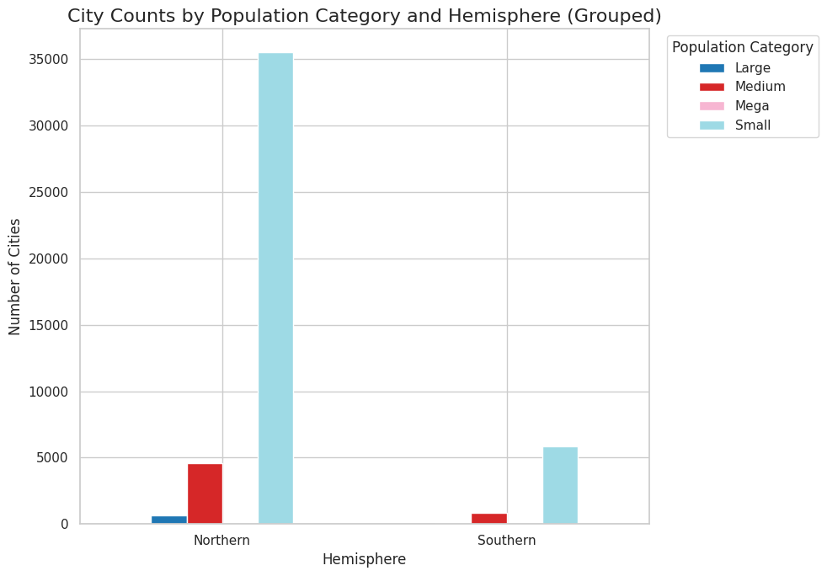

Slide 23
Conclusion
In conclusion, analyzing global city data revealed key patterns. After cleaning the data to ensure reliability, we observed that cities are concentrated in certain countries like the US, China, and India. Interactive maps clearly showed where cities are located worldwide. We identified the most and least populated cities and noted that a few megacities hold a large portion of the global population. We also found differences in city size distribution between the Northern and Southern Hemispheres. Countries like China and India have many cities with large populations. Overall, this analysis provides valuable insights for urban planning and demographic studies.

